Slide 1
RVC
Robot Vacuum Cleaner

Slide 2
RVC system
System point of view
As if we were a company producing the RVC system
Dyson, Ariete, Moulinex

Slide 3
Req document
Stakeholders
Context diagram + interfaces
FR + NFR
UCD + UC + scenarios
Glossary
System design
Deployment diagram

Slide 4
Stakeholders
End users (customers who will use the RVC system)
Component producers
Retailers (mediaworld ..)
Competitors
Std for power supply
Environment (houses or offices or industrial?)
Inside company
Marketing office
Design office
Software office
Engineering office

Slide 5
Context diagram
Actor: end user
Actor: power supply
Actor: maintenance server
interfaces
Actor | Log interface | Physical interface
End user | Start stop , .. | 3 buttons
Power supply |  | Plug schuko 3 poles, 220v
Maintenance server of producer company | Look for update, install update | Wifi connection

Slide 6
Functional requirement (system level)
Clean floors of house in autonomous way (without human intervention)

Slide 7
Non functional req
Countries where the system will be sold: Europe, USA, ..
Will induce choices on power supply, like 110V 220V, 50 60hz, plugs and cords
Will induce constraints on certifications, like CE label, ..
Usability
Any non technical person should be able to use the system without training
Efficiency
power consumption less than 40w
Min surface of house that can be cleaned with no interruption = 100sqm
Will induce NF req on capacity of battery, power of engines etc
Will induce NF req on consumption of ‘software’
Safety: no harm to people, animals, objects
Speed of robot no more than .. m/sec

Slide 8
Domain requirements
(hidden requirements about the domain)
Floor of house is flat
Floor of house is mildly dirty (no heavy dirt like in industrial environment)

Slide 9
Note about NFR: these NFR are system level, so do not follow the taxonomy of sw requirements (ISO 9126, maintainability portability efficiency …)

Slide 10
F requirements (Robot level)
Safety requirements
Monitor speed and limit it to .. m/sec
Stop if obstacle encountered
Force shutdown in case of harmful situation
Manage Energy
Read battery capacity
Estimate distance that can be travelled with current capacity
Monitor recharge of battery
Manage upgrades
Check if upgrade is available
Read current version number
Download firmware upgrade
Install firmware upgrade
Self test
Check each component (sensors, engines, ..) a, b .. and notify defects in case of
Manage remote communications
Send / receive messages with company server

Slide 11
F requirement (Robot level)
Manage movement of robot
Move from position A (here) to position B
Define a turnaround of an obstacle
Define a turnaround of a gap
Cover (and clean) a surface
Define a path to cover all the surface
Follow a given path
Learn a house map of the surface of the house
Interrupt / resume a surface cover
Manage Obstacle
Recognize obstacle (fixed, movable, moving)
Recognize gap
Clean
Operate cleaning device
Check if floor is clean (feasible??)

Slide 12
F requirement (smartphone level)
Manage user interaction (on smartphone app)
Set robot On off
Start
Learn
Show history (when cleaned)
Show consumption
Show path followed for cleaning
Show map and obstacles
Modify map
Define plan of cleanings for week / day / month

Slide 13
UC, scenarios

Slide 14
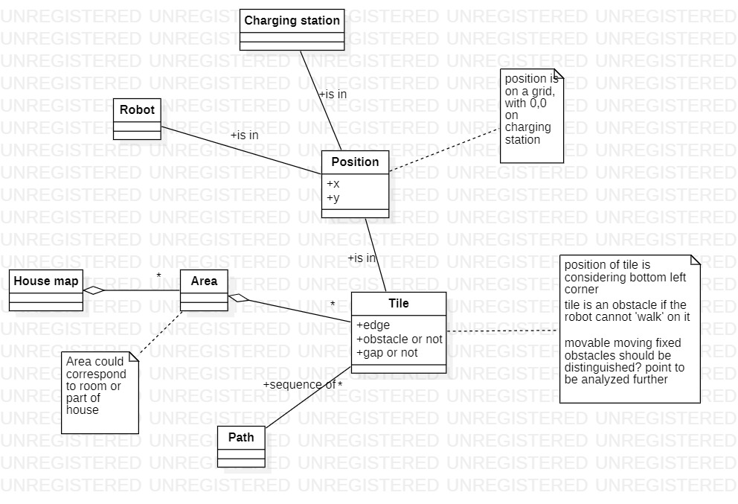
Glossary

Slide 15
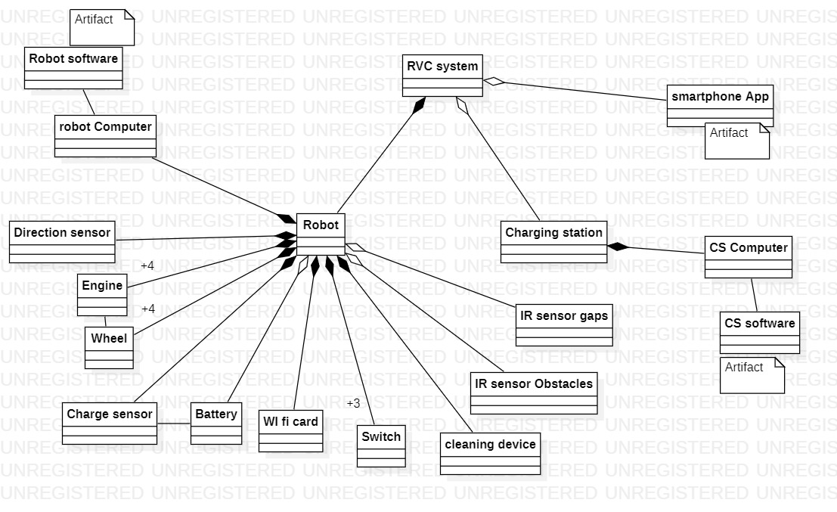
System design

Slide 16
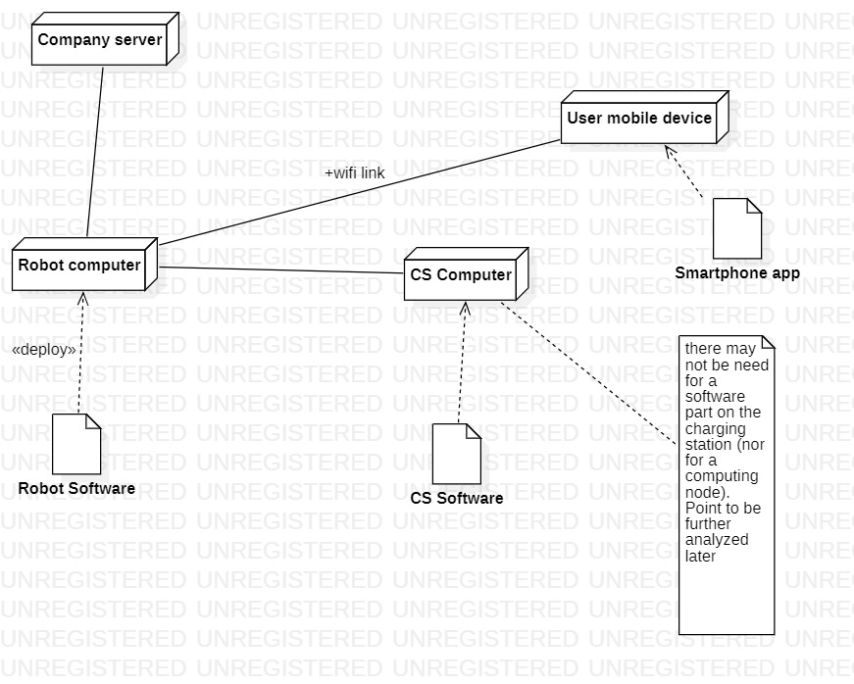
Deployment diagram

Slide 17
In the following each component of the system (robot, charging station, smartphone app) should be analysed producing a possibly complete requirement document
Robot
Context diagram, interfaces
FR, NFR
UCD
System design
Deployment diagram (not needed in this case)
Smartphone app
Context diagram, interfaces
FR, NFR
UCD
System design (not needed in this case)
Deployment diagram (not needed in this case)

Slide 18
Robot
Context diagram
User
Charging station
Obstacles
Maintenance server of company
FR
See slides 10, 11
Send / receive messages with smartphone app

